Slide 1
Huff Research Group Kendra Andersen
Group Meeting 11/20/17

Slide 2
Project Description
Navigation in Radio Frequency Landscapes using Autonomous Vehicles and Multiple Antenna Systems
Collect data on signal strength of various antenna systems using autonomous rovers.
Develop algorithm to plan a route for the rover which maximizes received signal strength (RSS).
Develop control strategy to examine signal strength at various frequencies for a GPS location and determine the best antenna configuration to maximize RSS.

Slide 3
Status
Last Week:
Coming up:
Started using Dijkstra’s algorithm to determine the best path in a RF environment.
Tested the algorithm using a simple set of paths & nodes.
Continue algorithm development to broaden its scope and automate graph creation.
Update the path-planning algorithm to use real data and to determine optimal paths in real-time.
Assist Ryan in collecting data.

Slide 4
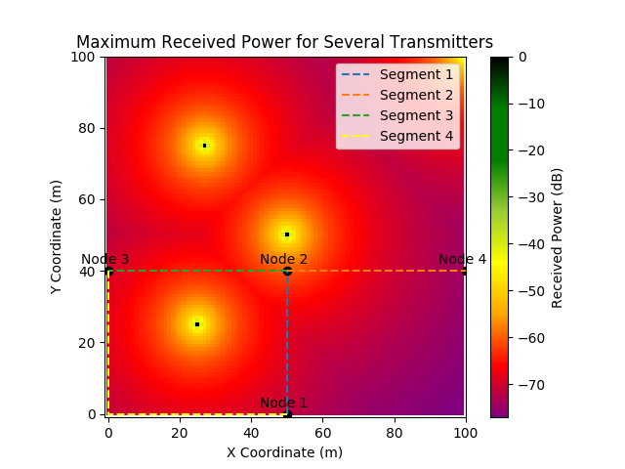
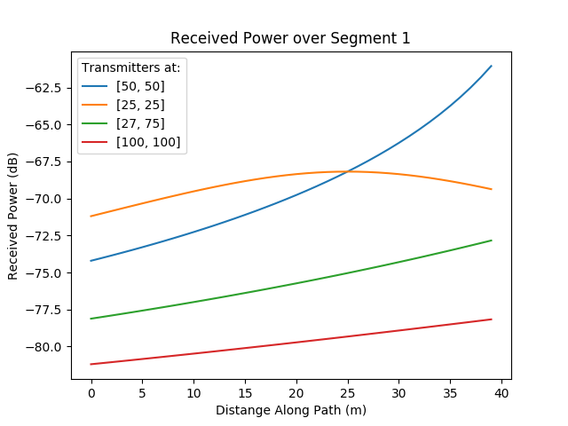
Findings/Progress

Slide 5
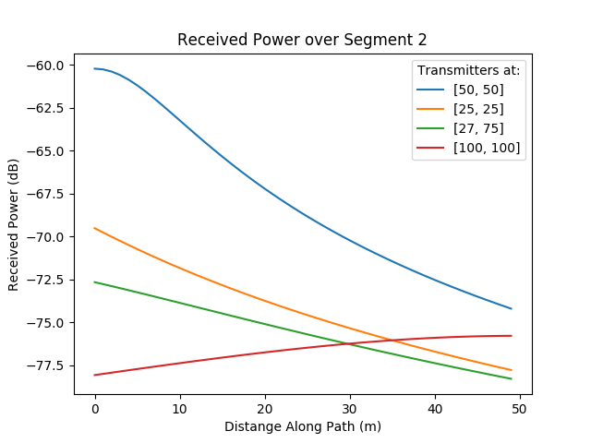
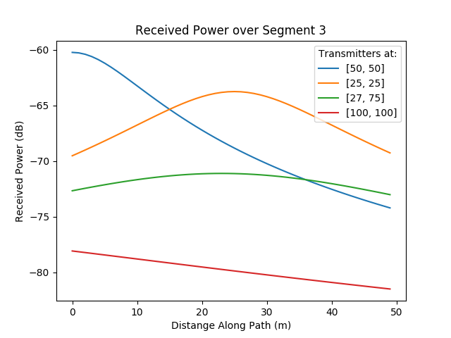
Findings/Progress

Slide 6
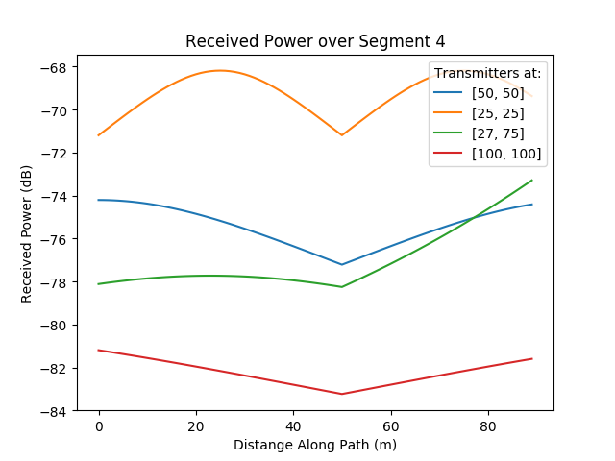
Findings/Progress
Sample output:
When integrating over the received power plots, assuming we are only concerned with the transmitter at [25, 25] for this path planning:
Finding a path from Node 1 to Node 3:
Shortest Path: [1, 2, 3] Cost: 6074.16878608
Seg 1 | Seg 2 | Seg 3 | Seg 4
-2764 | -3710 | -3310 | -6231

